Slide 1
Data Mining and Machine Learning for Business
DSCI 5240

Slide 2
Logistic Regression
Machine Learning
Supervised Learning
Classification
Logistic regression

Slide 3
Classification
Dependent variable (or response variable) takes value from a set, e.g.
result={win, lose}
Purchasedproduct={chocolate, ice cream, vegetable,…}
Fraud={Yes, No}
Given a feature vector X and a response Y taking values in the set C, the classification task is to build a function C(X) that takes as input the feature vector X and predicts its value for Y ; i.e., C(X) ∈ C.
Often, we estimate the probabilities that X belongs to each category in C

Slide 4
Popular classification techniques (classifiers)
Logistic regression
Tree-based Methods
Decision Tree
Random Forest
Bayesian methods
Naïve Bayesian
Linear Discriminant Analysis
Quadratic Discriminant Analysis
K-Nearest Neighbours
Support Vector Machines
Neural networks

Slide 5
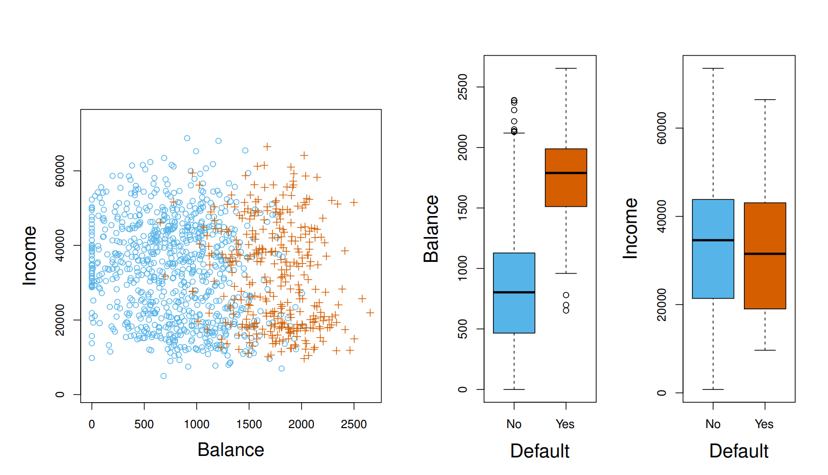
An Example
Y: whether an individual will default on his or her credit card payment
Xs: monthly income and credit card balance
Blue: Not default
Orange: default
To explore the relationship between default and balance / Income, use boxplots across categories.

Slide 6
Can we use linear regression?
Suppose for the Default classification task that we code
Y = 0 if No
Y = 1 if Yes
Can we simply perform a linear regression of Y on X and classify as Yes if predY > 0.5?
In this case of a binary outcome, linear regression does a good job as a classifier
However, linear regression might produce probabilities less than zero or bigger than one.
Logistic regression is more appropriate

Slide 7
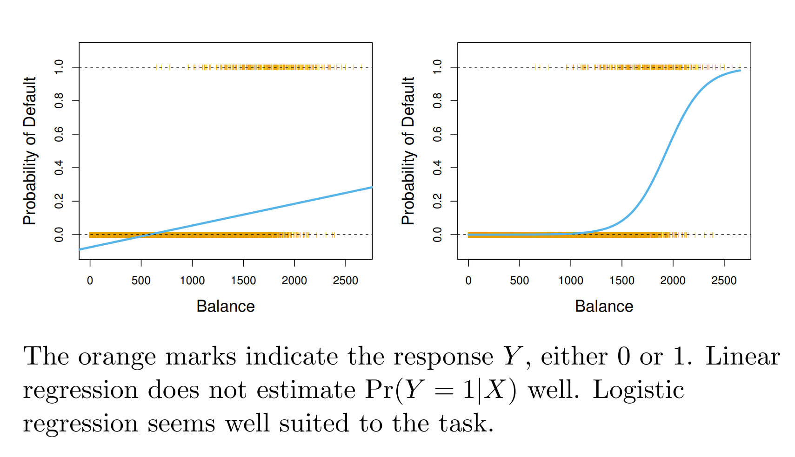
Linear vs. Logistic Regression

Slide 8
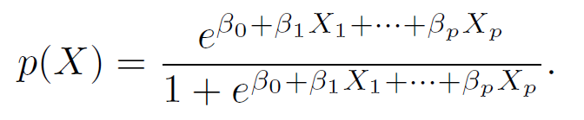
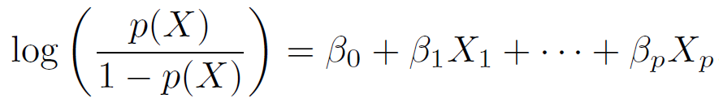
Logistic regression - Model
Let’s write p(X) = Pr(Y = 1|X) for short. Logistic regression uses the form
It is easy to see that no matter what values β0, β1 or X take, p(X) will have values between 0 and 1
Rearrange the function, we have
This monotone transformation is called the log odds or logit transformation of p(X)
Logit has a linear relationship with X
(e ≈ 2.71828 is a mathematical constant [Euler’s number.])

Slide 9
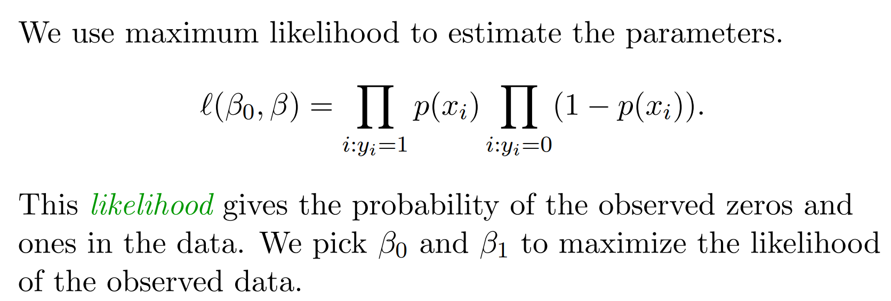
How to find parameter values? – Maximum Likelihood
Write the probability function of each Y and Xs using the logistic formula
Multiply all of the probability together to get the likelihood function
Maximize the likelihood by choosing the best parameter values

Slide 10
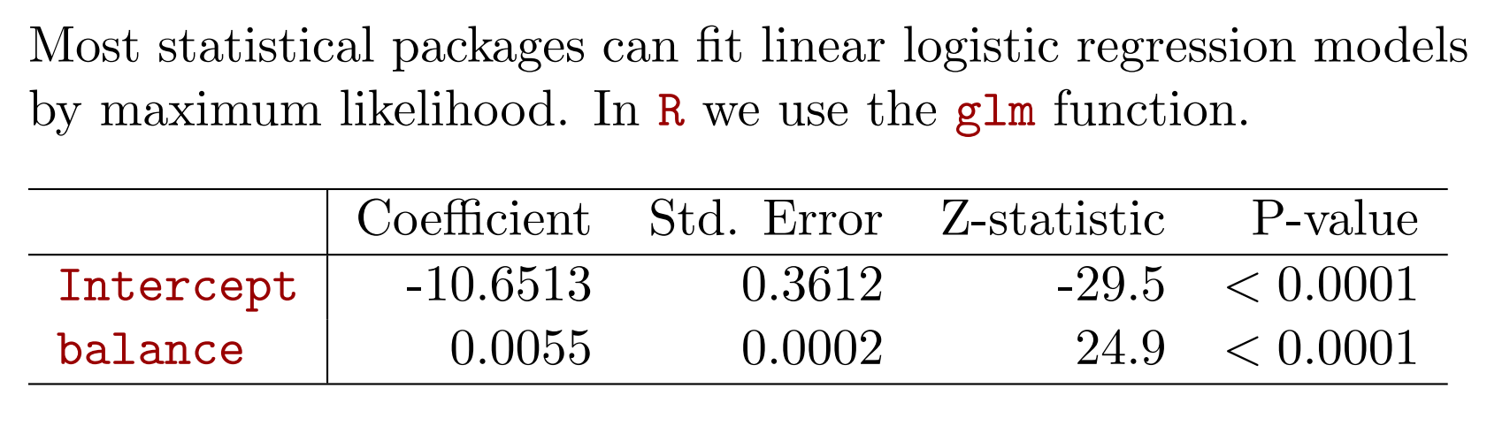
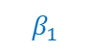
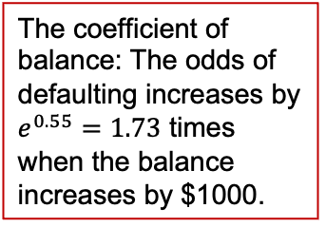
The output for a single variable
The coefficient of balance: The odds of defaulting increases by $e^{0.55}=1.73$ times when the balance increases by $1000.
The estimated standard deviation
The probability of observing such z-statistic given to be 0
$$β_{1}$$

Slide 11
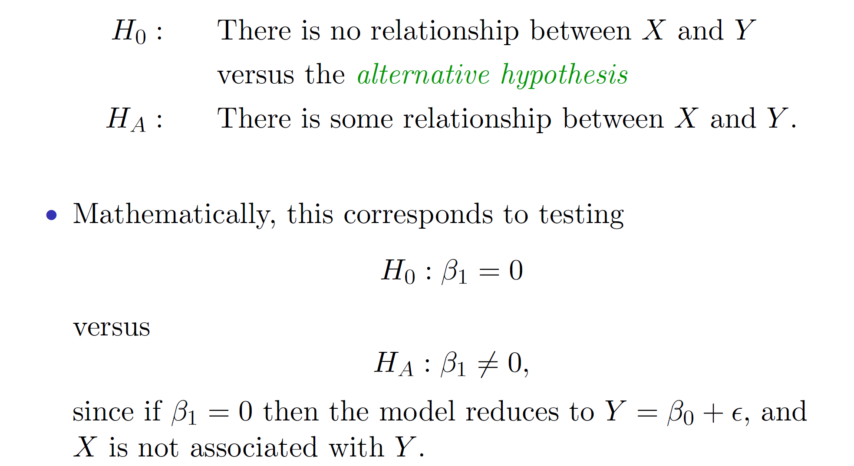
Q1. Which factors are important in predicting Y?
The outcome of the test exhibits in p-values: if p-value is less than 5%, we are confident to reject the null hypothesis.
That means, the alternative hypothesis is correct.
Given H₀
Calculate z-statistic
P-value: whether to reject H₀
There is / isn’t a relationship between X and Y

Slide 12
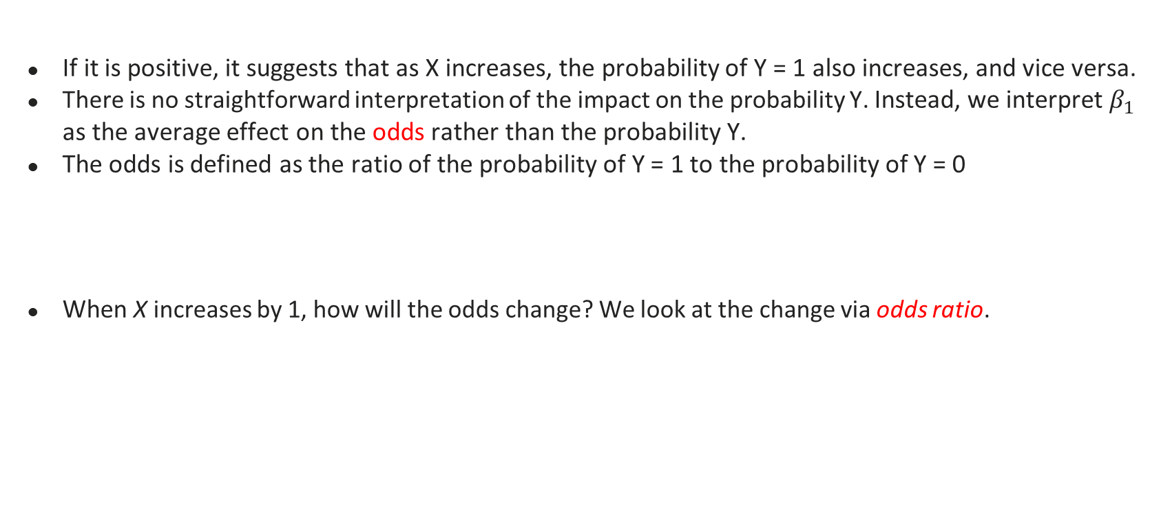
Q2. How does each factor affect Y?
If it is positive, it suggests that as X increases, the probability of Y = 1 also increases, and vice versa.
There is no straightforward interpretation of the impact on the probability Y. Instead, we interpret $β_{1}$ as the average effect on the odds rather than the probability Y.
The odds is defined as the ratio of the probability of Y = 1 to the probability of Y = 0
When X increases by 1, how will the odds change? We look at the change via odds ratio.
$the odds= \frac{p}{1−p}$ $=e^{β_{0}+β_{1}X+ε }$, where p is the probability of Y = 1
Examples: For probability of 0.5, the odds is 1.
After
Before

Slide 13
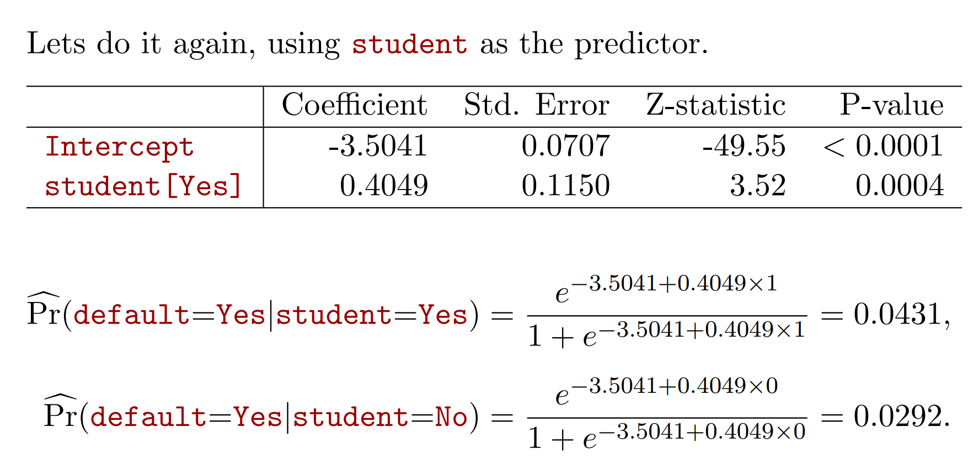
Q2 Continued – For categorical variables
The odds of defaulting increases by $e^{0.4}=1.51$ times when the borrower is a student, comparing to a non-student borrower.

Slide 14
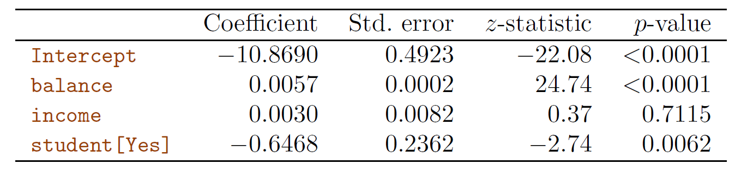
Multiple Logistic regression
Why is coefficient for student negative, while it was positive in the one-variable model?
If we do not consider any other factors, students tend to default more.
If we take into consideration other factors, e.g., balance, further examination will find that these two are correlated: students have more balance than non-students
For the same level of balance, students are less likely to default
The positive effect in the single variable model captures the confounding effect of balance together with being a student
If we tease out the effect of balance by including it as a variable, we can find the effect of being a student by itself

Slide 15
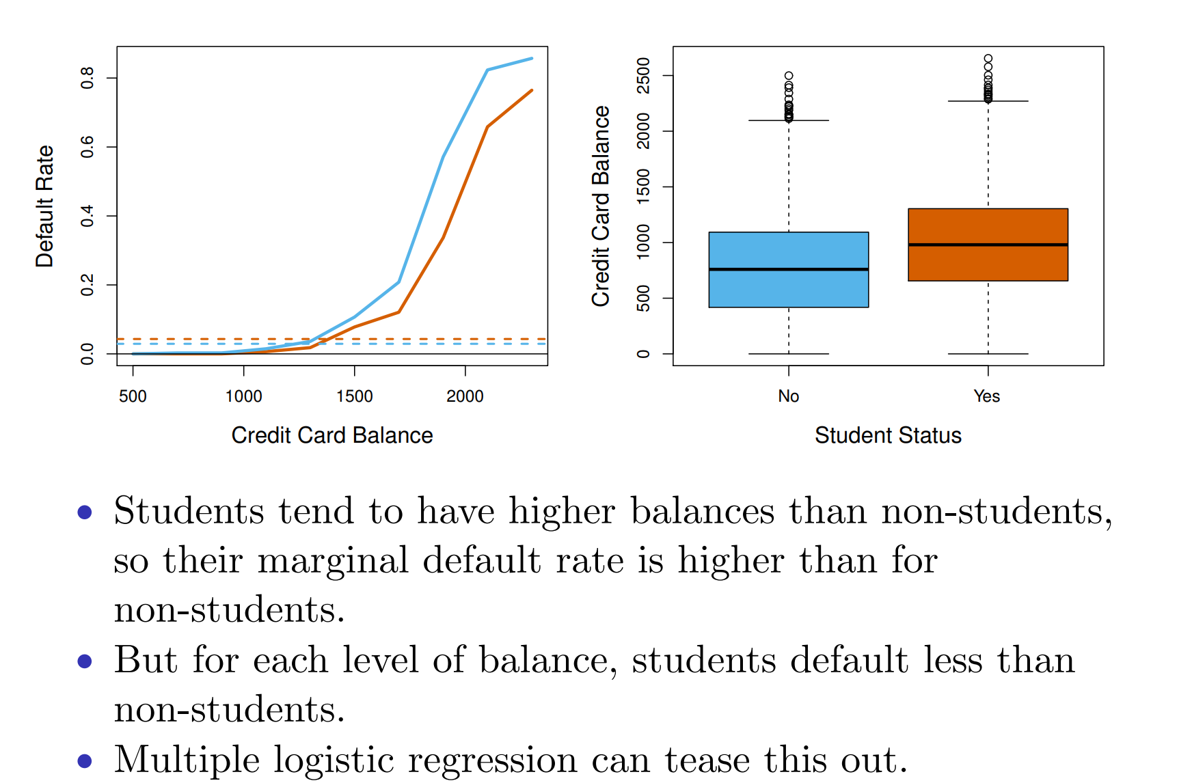
The confounding effect of balance and student

Slide 16
Q3. How to classify?
It is straightforward to predict probability of Y = 1 using the estimated coefficients and the model
The classification is based on probability values
Establishing cutoff level; If estimated prob. > cutoff, classify as “1”, e.g., if p>0.5, the prediction is classified as 1;
If the estimated probability is 0.67, the person is predicted to default the payment

Slide 17
Takeaways
Classification and popular classifiers
Logistic regression model specifications
Key questions about the results
Which factors are more important predicting Y?
How does each factor affect Y?
How to classify?

